Slide 1
Task 1
Web Scraping to gain company insights

Slide 2
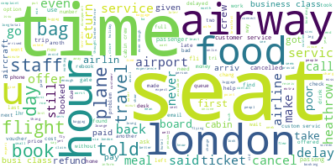
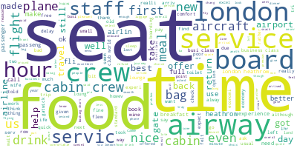
Insights
Negative Word Cloud
Our approach was to first do sentiment analysis on the comments to categorize them into positive or negative statements.
Having this in hand, we tried to see what aspects of BA did the comments talk about more in the above categories
We visualized this using the word cloud Library.
For instance, The term 'Food' appeared more frequently in the positively classified comments, hence it is much bigger in the Positive Word Cloud
Positive Word Cloud

